Slide 1
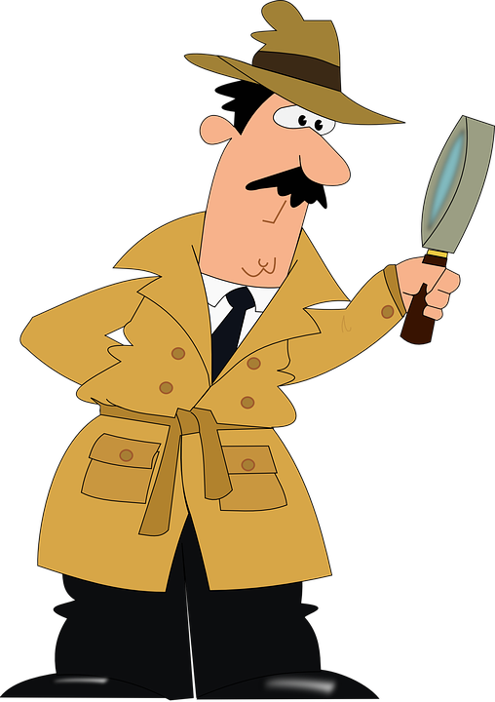
You are a social detective!
What is a social detective?
Someone who uses CLUES to help them figure out what to do when they’re around other people.

Slide 2
You are a social detective!
His brain helps him think about what is expected.
His eyes help him look for clues.
His ears help him listen for clues.

Slide 3
You are a social detective!
Thinking with your eyes is a SUPERPOWER!
Your eyes can help you see CLUES that help you make a smart guess about what other people might be doing or thinking about.
Sometimes these clues help you figure out what you should be doing or thinking about.

Slide 4
Let’s practice! Click on the TV to get started!

Slide 5
Let’s practice! Think with your eyes to answer the questions below.
What is the boy thinking about?
How do you know?
Make a prediction! What do you think he will do next?
The boy is thinking about Oreos.
He is looking at the Oreos.
I think he will eat the Oreos.

Slide 6
kids
Let’s practice! Think with your eyes to answer the questions below.
What are the kids thinking about?
How do you know?
Make a prediction! What do you think they will do next?
They are thinking about the pool.
They are looking at it with their body.
I think they will get in the swimming pool.

Slide 7
kids
Let’s practice! Think with your eyes to answer the questions below.
What are the people thinking about?
How do you know?
Make a prediction! What do you think they will do next?
They are thinking about toys.
They are looking at the toys and they are holding the toys.
I predict they will buy it and take it home.

Slide 8
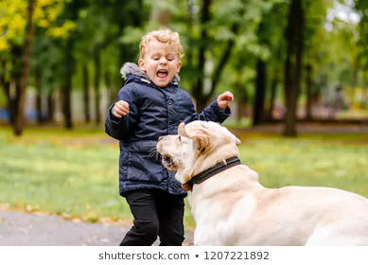
kids
Let’s practice! Think with your eyes to answer the questions below.
What is the boy thinking about? How is he feeling?
How do you know?
Make a prediction! What do you think he will do next?
He is thinking about the dog. He is feeling scared.
His mouth is open.
I predict he will run away from the dog.

